Slide 1
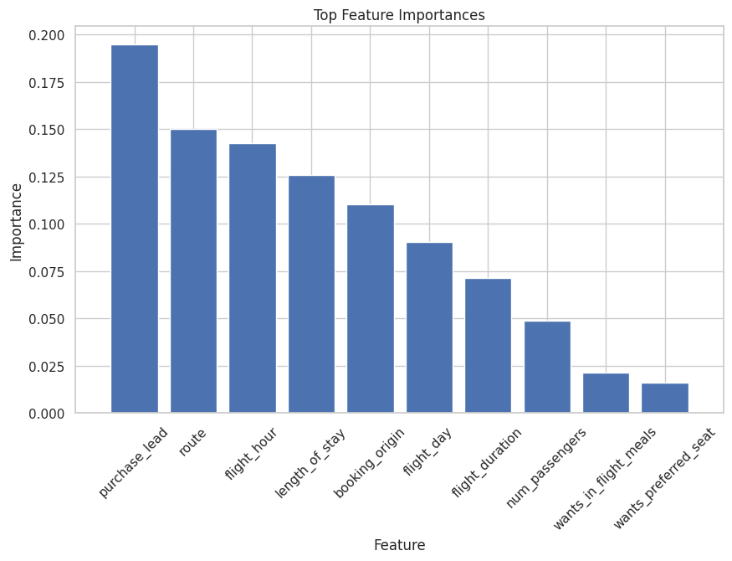
Factors Influencing Customer Buying Behaviour
Understanding customer buying behaviour is critical for optimizing sales and revenue. This analysis focuses on identifying key factors that influence customers to complete a booking with British Airways. A random forest model was developed and achieved an accuracy and precision of 85% and 57% respectively
Mutual information analysis identified the following influential factors are ROUTE, BOOKING ORIGIN, WANTS EXTRA BAGGAGE
and FLIGHT DURATION. However the machine learning model delved deeper into these factors and how opportunities can be improved:
PURCHASE LEAD: Target early planners with tailored promotions.
ROUTE: Highlight appealing routes and unique experiences.
FLIGHT HOUR: Offer flexible schedules to accommodate preferences.
LENGTH OF STAY: Promote diverse holiday packages.
BOOKING ORIGIN: Customize marketing by origin

